Slide 1
The Hutchins Center Fiscal Impact Measure and the Near-Term Outlook for Fiscal Policy
Louise Sheiner
The Hutchins Center on Fiscal and Monetary Policy
The Brookings Institution
October 2020

Slide 2
Outline
What is the FIM?
What is the implicit counterfactual?
What’s included?
Reallocations between Federal and State and Local government
Choice of MPCs
Analyzing the recent pandemic legislation: UI, Rebate checks, PPP, Grants to S&L govs
Work with Hamilton Project: How much stimulus needed to get rapid recovery?

Slide 3
What is the FIM
Measure designed to capture the direct effects of fiscal policy on real GDP growth.
What is stimulative versus restrictive policy? We define it relative to potential GDP growth.
If real purchases rise less than potential GDP, then fiscal policy is a factor holding GDP growth below potential, and is restrictive.
Similarly, if net transfers (transfers less taxes) growing slower than potential, policy is restrictive.
We use CBO’s estimates of potential.

Slide 4
What’s in the FIM?
All purchases, taxes, and transfers at both federal and state and local levels.
Includes discretionary fiscal policy
Includes automatic stabilizers (unlike FI at the FED).
Doesn’t differentiate between regular UI versus legislated increases in UI, or automatic reductions in tax revenues vs legislated ones.
Because taxes grow more slowly than potential during downturns, we capture lower taxes (automatic stabilizers) as being stimulative.
Includes trends in spending – e.g., rising health spending directly increased fiscal policy’s effect on GDP. (unlike FI at the FED).
What’s not in the FIM? Multipliers.
FIM only captures direct effect.
e.g. If purchases increase in a full-employment economy and Fed offsets with higher interest rates, net effect of fiscal policy might be zero, but we’d show it as stimulative.
And then you’d ascribe an offsetting negative to monetary policy. (But that’s not in the FIM.)
What’s not in the FIM? Monetary policy, Fed lending facilities.

Slide 5
Reallocations and other differences from NIPA
We reallocate spending across federal/state and local so that it is tied to which level of government finances it.
All UI is federal according to NIPA, even though regular UI state financed.
All Medicaid is state in NIPA, even though 60%+ financed by federal gov.
All S&L purchases are state even if financed through Federal grants.
In addition, as already noted, we subtract a “neutral” purchases growth from our contributions.
While we think our method makes sense, it has led to confusion when comparing NIPA contributions with our #s for purchases by level of government.
We are planning on providing a cross-walk for those who want to see how we go from the NIPAs to our numbers.
Note that reallocation only affects the division of the FIM between federal and S&L—not the top line.
Evaluating relative to potential affects the “zero” but not the basic shape of the FIM.

Slide 6
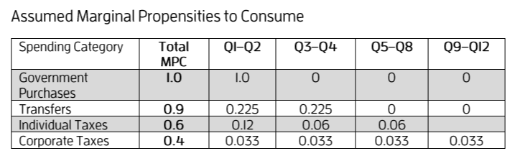
Choosing MPCs
MPCs for taxes and transfers:
How much spending out of a given $1 in lower taxes or higher transfers, and what is the timing?
Our assumptions for history:

Slide 7
Choosing MPCs for Recent Legislation
UI: 90% of the money spent over six quarters. Spendout slowed by generous but temporary increase in UI and social distancing.
Rebate checks: 70% total spent over 8 quarters-with 35% spent in first quarter.
PPP: Most of the $ went to higher profits, rather than maintaining payroll. We assume 45% of the money spent over three years.
Aid to State and Local Governments: We are using CBO projections of S&L purchases, but need to assign a timing for when money from the grants will be spent (to divide spending between federal and S&L). Assume grants boosting spending over 12 quarters.
Recent evidence suggests hit to S&L sector not as big this year as previously thought. S&L govs seem likely to save some of the aid for future years.

Slide 8
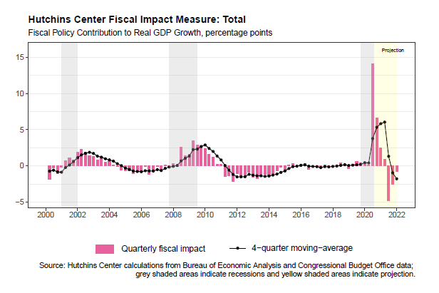
The Latest Reading on the FIM (slightly different from what’s online)
Fiscal Policy has massive impact on Q2 – boosting it 14% at AAR.
Implies GDP decline would have been 45% without stimulus.
Policy fades over time and then—without further legislation—turns negative by second quarter of next year.
Obviously lots of uncertainty about exact magnitudes and timing.

Slide 9
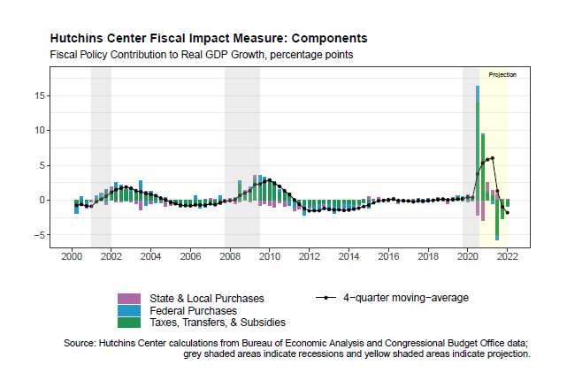
The Latest Reading on the FIM – Components
Most of stimulus from transfers – UI, Rebate Checks.
Aid to states shows up as federal purchases here (we reassign spending).
Implicitly a counterfactual about what states might have done without stimulus $ --- obviously extremely uncertain in terms of timing.

Slide 10
Using FIM-Like Calculation to Assess Benefits of Additional Fiscal Stimulus
Based on recent work with Wendy Edelberg (www.brookings.edu/research/what-could-additional-fiscal-policy-do-for-the-economy-in-the-next-three-years/)
Assessed the likely impact on GDP of an illustrative stimulus package
Illustrative package totaled $2 trillion in spending, with $400 b each in:
Rebate checks
Additional UI ($300 per week for 12 months)
PPP
Aid to S&L Governments
Money for public health, higher education, airlines.
Similar MPCs to ones I showed for the FIM for recent legislation.
Different from the FIM in that it includes multipliers so as to capture total effect on GDP.
Multipliers based on CBO but somewhat lower because of social distancing.

Slide 11
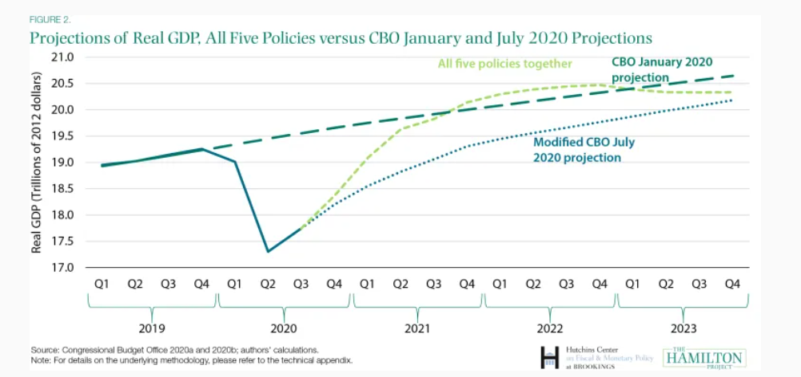
With package, back to baseline by end of 2021; without it, CBO projects decade-long recovery

Slide 12
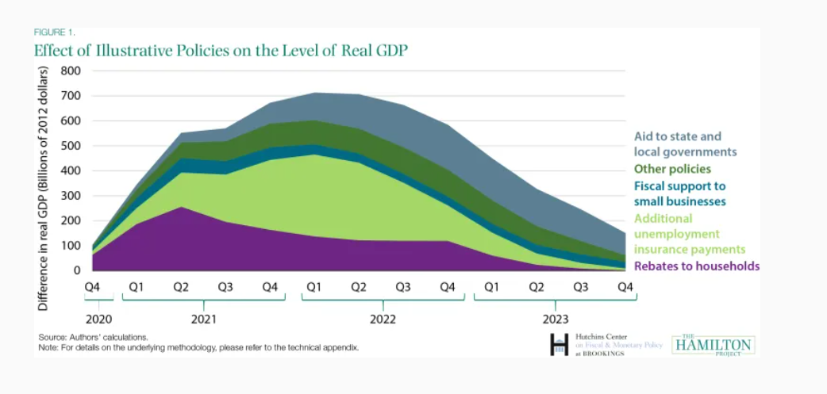
UI has biggest “bang for the buck.” Rebates the quickest.

Slide 13
Obviously, a lot of uncertainties
When will social distancing end – we followed CBO in assuming over by end of 2021 Q2 – that seems somewhat optimistic now
What would spendout be if new checks disbursed? How much lower because of social distancing?
Would there be significant labor market effects if UI benefits increased $300 per week for a whole year? We assumed not.
What is happening in S&L sector?
How much are losses in employment due to closing vs $?
My recent BPEA paper showed $155 b revenue loss in 2020, less than $212 b state aid. But how much extra $ needed for COVID? And losses in 2021 and 2022 likely to be significant, with no more aid forthcoming.
Would providing more $ unleash spending, or would it be saved?

Slide 14
Other Considerations
Obviously don’t choose components of stimulus package just because of macroeconomic effects.
Increasing duration and $ of UI most important from perspective of addressing need. Also happens to have biggest bang for the buck.
Aid to state and local governments –perhaps tied to education spending—may be really important in addressing growing gap in educational progress by income group.
Allowing lower-income kids to fall behind educationally would be long-lasting horrible outcome of COVID. Government needs to do everything it can to prevent this.
Perhaps also need targeted aid to industries that should stay closed or operate at reduced capacity—bars, indoor dining—to help limit spread of virus and to ensure these businesses ready to reopen quickly once it is safe to do so. (But I don’t worry too much about the ability of bars and restaurants to open quickly.)

